Slide 1

Journey Toward Safety Excellence
Name
Board Title
Event (i.e. Region IX 2026)
Notes:
Introduce yourself and state your position on the National Board.
Be sure to recognize the Regional board, National Board attendees and any OSHA officials (Federal, Regional or State) in attendance.

Slide 2

Session Overview
What is VPP?
Successes – and challenges – facing VPP &
SHMS adoption
VPPPA’s Mission and support
VPP’s next 43 years – journey for
every workplace (where VPP may not
be the end result)
Open forum – how can we grow VPP &
SHMS use nationally? Internationally?
Notes:
This model is based in VPP so we will review the basic VPP program. This will include the challenges to VPP and how VPPPA has revamped its long standing mentoring program to Journey Towards Safety Excellence for any site wanting to advance their Safety & Health Systems.

Slide 3
What is VPP?
Formally established by OSHA in 1982
  1979: San Onofre Nuclear Power Generating Station
Safety & health management system
  Built on 3 pillars: front-line employee involvement, management commitment & regulatory oversight
Four core elements
  Management Leadership & Employee Involvement
  Worksite Analysis
  Hazard Prevention & Control
  Safety & Health Training
Notes:
So let’s review what VPP is as the basis for the Journey Towards Safety Excellence Program

Slide 4
How does VPP work?
When participating in VPP, management, employees (company and contracting), and OSHA work in a cooperative relationship at a workplace that has implemented a strong effective safety and health program.
Management agrees to operate an effective safety and health program meeting established criteria with employees to continuously improve the program.
Employees agree to actively participate in the program and work with management to assure a safe and helpful workplace.
OSHA performs a series of audits and inspections to ensure the program meets VPP criteria.

Slide 5
VPP Participation: Requirements
VPP Application
  Union sign-off
  Assurances to OSHA
Certification audit
Annual self-evaluation
Recertification audit every 3-5 years
Process: 6-24 months from application submission to approval

Slide 6
Labor- 43 of 70 VPP Sites in California (61%)
42 Union VPP STAR Sites- Ca January 2025
Aerojet Rocketdyne | Union: UAW (local 887), AFL-CIO Local 461, IBEW Local 2295, Carpenters Local 721, and Teamsters Local 578
Bimbo Bakeries USA | Union: Bakers, Confectioners & Tobacco Workers Union Local #31
BrandSafway Scaffolding Services | Union: Southwest Regional Council of Carpenters
Blythe Energy, Inc. | Union: IBEW Local 47
CP Kelco | Union: International Union Operating Engineers Local Union 501 International Union of Operating Engineers, AFL - CIO
D2 Industrial Services LLC | Union: Local 16. Heat & Frost
E. & J. Gallo Winery, Livingston | Union: United Food & Workers' Commercial Union, Local 180D
E & J Gallo Winery Spirits Plant | Union: UFCW Local 186d
Eastern Municipal Water District (EMWD) Administration and Support | Union: IBEW
Eastern Municipal Water District (EMWD) Water Operations, Production and Treatment Division | Union: IBEW
Additional Sites: | Union: IBEW
Hemet Water Filtration Plant, | Union: IBEW
Menifee Desalter, | Union: IBEW
Perris Desalter, | Union: IBEW
Perris Water Filtration Plant, | Union: IBEW
Sun City Treatment Plant, | Union: IBEW
Eastern Municipal Water District (EMWD) Water Reclamation and Collections Division | Union: IBEW
Additional Sites: | Union: IBEW
Moreno Valley Regional Water Reclamation Facility | Union: IBEW
Perris Valley Regional Water Reclamation Facility | Union: IBEW
San Jacinto Valley Regional Water Reclamation Facility | Union: IBEW
Temecula Valley Regional Water Reclamation Facility | Union: IBEW
Collections Division | Union: IBEW
Guarantee Electrical Construction Company | Union: International Brotherhood of Electrical Workers, Local Union 180
Morton Salt Long Beach | Union: Teamsters Union Local 848
Orange County Sanitation District (OCSAN) - Reclamation Plant No.1 | Union: International Union of Operating Engineers, Local 501
Raytheon Company | Union: Cabinet Makers & Millmen Local 721; International Brotherhood of Electrical Workers (IBEW)
Raytheon Intelligence and Space - El Segundo | Union: Cabinet Makers, Millmen & Industrial Carpenters, Local 721; International Brotherhood of Electrical Workers (IBEW) Local 2295
Sacramento Municipal Utility District Hydroelectric Generation - Fresh Pond | Union: IBEW Local 1245
United Airlines, Inc. (SFO Above-the-Wing) | Union: International Association of Machinists Local 141
Federal/Construction Union VPP Sites in CA
Marine Corps Logistics Base (MCLB) | American Federation of Government Employees
C. Overaa & Company | Council of Laborers and Carpenters
D2 Industrial Services LLC | United Steel Workers - IUPW
AECOM Turner, NBA Joint Venture ‑ Intuit Dome Stadium Project | Union: Ironworkers Local 433, Electrical Workers IBEW Local 11, Pipe Trade UA Local 78- Plumbers, Carpenters Local 213,661,323,714,805
Cahill Contractors LLC ‑ Depot Road Project | Union: Carpenters Local 22, IBEW Local 595, Labor Union Local 119, Operating Engineers Local 3
Cahill Contractors LLC ‑ Madrone Terrace Project | Union: Carpenters Local #22, Laborers Local #261, Operating Engineers Local #3, IBEW Local #595
Cahill Contractors, LLC ‑ Shirley Chisholm Village Project | Union: Carpenters Local #22, Laborers Local #261, Operating Engineers Local #3, IBEW Local #595
DPR Construction – Torrey Pines Science Campus Project | Union: 619 Carpenters, 89 Laborers
Rudolph & Sletten ‑ CSUSB Performing Arts Building Project | Union: Laborers, Carpenters, Cement Masons
Rudolph & Sletten – Scripps Health Encinitas – Acute Care Building Project | Union: Carpenter Union, Local 619, Laborers Union, Local 89, Cement Masons, Local 500
Rudolph & Sletten - Veteran’s Home-Yountville Skilled Nursing Facility | Union: Laborers Local 324, Northern CA Carpenters, Local 46, Cement Masons, Local 400, Operators Engineers, Local 3, Electrician’s, Local 180, Plumbers/Pipefitters, Local 343, Glaziers, Dist. Council 16, Local 767, Fire Sprinkler Pipefitters, Local, 483, Iron Workers, Local, 378, Pile Driver, Local, 34, Sheet Metal Workers, Local 104, Painter, Dist. Council, Local 16, Flooring, Dist. Council, Local 16&12, Drywall Finisher, Dist. Council Local 16 & 767, Plaster, Local 300
SOLV Energy ‑ Victory Pass Project | Union: IBEW 440, Laborers' International Union of Northern America #1184, SWRCC
Sources: List of Cal/VPP STAR Sites List of VPP - Construction Participants
Unions in VPP Federal and State Plans | Occupational Safety and Health Administration
Notes:
VPP is labor driven process and includes employee engagement

Slide 7
VPP Successes: the SHMS Model
1,889 companies and sites
  1,133 federal
  756 state-plan
474 local signatories
Lagging indicator performance
  TCIR: 53% lower than BLS average
  DART: 57% lower
  4,035 expected TCIR injuries avoided
Special Government Employee (SGE) program
Sources: https://www.osha.gov/vpp/evaluation2021
Notes:
This model is very effective at reducing Injuries and sites can achieve the same injury reduction without achieving OSHA VPP certitificaiton.

Slide 8
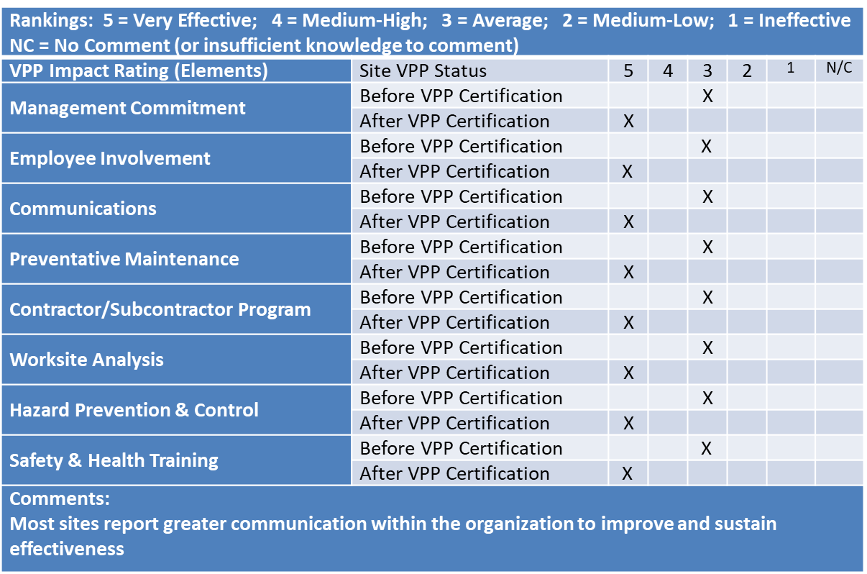
Cal/VPP Business Value Survey
Source: https://www.dir.ca.gov/dosh/cal_vpp/documents/July-2024-Workshop/Overview.pdf
Notes:
Cal-OSHA has performed a business value survey for the past 10 years and noted that this model makes good companies great!
The biggest advantage is the increased communication across the organization and increased employee/management relations.

Slide 9
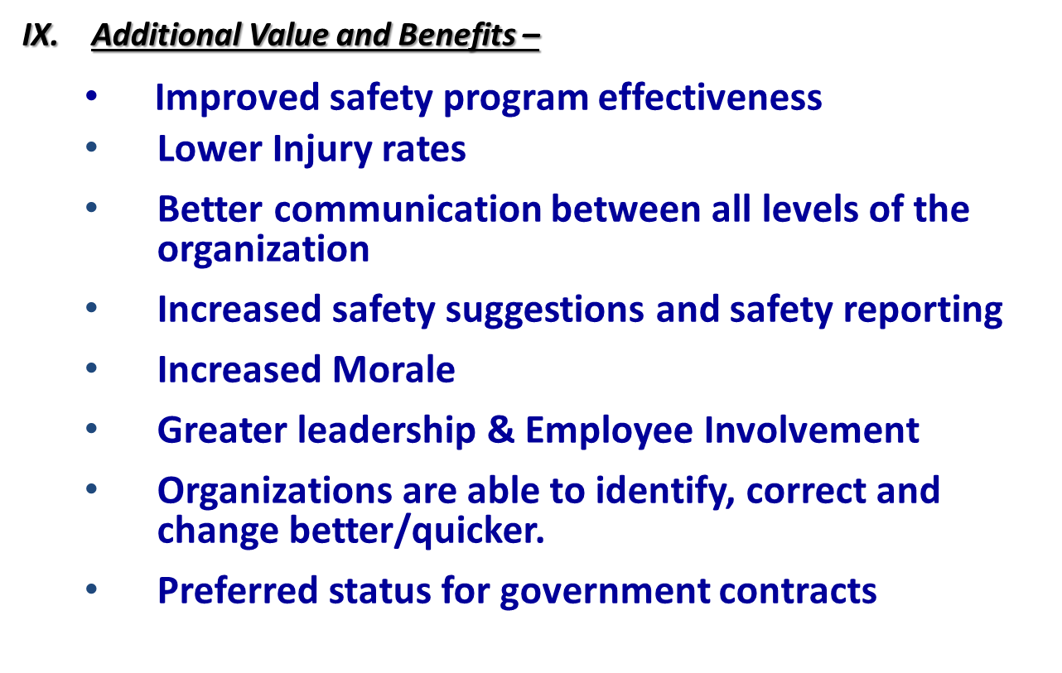
Cal/VPP Business Value Survey
Source: https://www.dir.ca.gov/dosh/cal_vpp/documents/July-2024-Workshop/Overview.pdf
Notes:
More benefits of this model are shown here. If sites are more reliable, more productive and more adaptable they are more profitable.

Slide 10
Challenges Currently Facing VPP
Technology
Approval timeline/process
Competition from third-party SHMS
Lack of awareness/image as a “program for big companies”
Lack of recognition beyond the U.S.
While still the “gold standard” of SHMS in terms of structure & requirements, VPP must evolve to become a true pathway & road map to EH&S excellence.

Slide 11
VPPPA’s Mission & Vision
Advancing health and safety excellence through collaboration, mentorship and education to raise the standard for a safe & healthy workplace.
We are an association representing VPP sites AND those companies/sites committed to higher standards of EH&S performance.
Notes:
VPPPA’s mission statement reflects the evolution of our association over its first 40 years as the representative not just for VPP sites, but for all companies and sites who share our commitment to advancing health and safety excellence. Our goal remains the same – to save lives through developing the new ideas, processes and best practices that all companies and sites may implement.

Slide 12
VPPPA’s Journey towards Safety Excellence
Tiered “journey” with benchmarks to acknowledge continuous improvement towards world-class
  Engage with broader user base by tailoring components of the pathway by industry (see: Construction)
Incorporation of crosswalks between VPP & third-party SHMS to streamline on-ramps
“Interchanges” – participants choose the best path (pursuit of VPP or continuing their safety journey) based on their needs
Expansion of SGE program (numbers and responsibilities)
Notes:
Review the benefits as listed in in the slide. Key point to make is although sites are assigned mentor (an SGE) you are being mentored by the mentors
company and get the resources (site professionals, polices and procedures) from the entire company site.

Slide 13
VPPPA’s Journey Toward Safety Excellence
On behalf of the Voluntary Protection Program Participants Association (VPPPA) the Mentoring committee would like to welcome you and offer our assistance on your Journey to Safety Excellence.
The VPPPA provides occupational safety, health and environmental leaders with networking and educational opportunities, up-to-the-minute legislative information, industry advancements, preferred vendors and unpaid consultants dedicated to safety and health management systems, mentoring resources, professional development, and volunteer opportunities.
The VPPPA is uniquely designed to support any company, site or organization looking to achieve safety & health program enhancement to excellence. Our 5 level Journey to Safety Excellence includes the following:
Level 1- Completing a questionnaire and gap analysis
Level 2- Signing a Commitment letter
Joining the VPPPA
Begin working with a mentor selected just for you.
Level 3- Develop and implement a Safety & Health Management System (SHMS)
Learn and Conduct Self-Evaluations using VPPPA’s audit tool
Continual review of programs and progress with assigned mentor
Level 4- Site visit to include a Mock OSHA style audit if desired.
Feedback and Assurance from authorized OSHA auditors on site SHMS effectiveness
Level 5- Support to apply for Safety & Health Recognition (i.e. VPP, ISO, ANSI, etc.)
If you are a VPPPA member and are interested in finding a mentor to help you on your journey toward safety excellent, you may request a mentor here.
If you are not a VPPPA member, you may also request a mentor by joining our safety and health community.
Please take a moment to learn more about the benefits of a VPPPA membership here or you may apply to become a member here.
We sincerely hope you will let us support your advancement of Safety & Health.
Notes:
VPPPA, in consulting with OSHA, has identified areas where the association and its members can play a pivotal role in helping OSHA bring VPP into its next 40 years. The board approved a VPPPA-VPP modernization plan with the goal of creating and evolving the resources, technology and pathways needed to grow VPP participation. Core elements—which you’ll see in a second—include the modernization of the Special Government Employee program to help with reducing application wait times; an OSHA Challenge program that serves as a true pathway into VPP using VPPPA’s mentoring program as a foundation, and the creation of a VPP-Construction framework for OSHA that takes into consideration the unique work environments encountered by construction companies.

Slide 14
VPPPA’s Journey Toward Safety Excellence
1
Complete Gap Analysis
Request a Mentor
Level
2
Level
Sign Commitment Letter
Review Gap Analysis with Mentor
Safety & Health Management System (SHMS) Implementation
EHS Self-Evaluation
Remote Paperwork Review
Progress Check-In
3
Level
4
Level
Mock Audit & Site Visit
Site Visit Feedback
5
Level
Apply for Safety & Health Recognition (If Desired)
Notes:
Review the slide as listed per level

Slide 15
The Journey’s “Fork in the Road” – Beyond Level 4
Completion of level 4 brings a choice for companies/sites
  Prepare for a VPP application & audit process
  Meet or exceed requirements for many third-party SHMS/standards (ISO45001, ANSI Z10, ABC STEP, etc.)
Do we pursue VPP or proceed on continuous improvement journey with fully-implemented SHMS, annual self-evaluation and regular audit process?
No right or wrong answer – performance & process improvement has already been achieved.
Notes:
Level 5 of this program includes a validation of the implemented SHMS. This ranges from the mentor performing a site visit ny the mentor to a mock audit
with an entire team. This validation process sets the site up to apply for whatever certification process (VPP, ISO ANSI, STEPS) if they wish to do so.

Slide 16
Resources
Chris Williams, CAE
Executive Director
Email: cwilliams@vpppa.org
Phone: (703) 761-6504
LinkedIn: in/cwilliamsvpppa
Xwitter: @cwilliamsvpppa
Terry Schulte, SMP, SGE, STM
Chairperson
Email: chair@vpppa.org
Phone: (707) 567-6885
LinkedIn: in/terry-schulte-2a814415

Slide 17

VPPPA’s Journey Toward Safety Excellence
Notes:
VPPPA, in consulting with OSHA, has identified areas where the association and its members can play a pivotal role in helping OSHA bring VPP into its next 40 years. The board approved a VPPPA-VPP modernization plan with the goal of creating and evolving the resources, technology and pathways needed to grow VPP participation. Core elements—which you’ll see in a second—include the modernization of the Special Government Employee program to help with reducing application wait times; an OSHA Challenge program that serves as a true pathway into VPP using VPPPA’s mentoring program as a foundation, and the creation of a VPP-Construction framework for OSHA that takes into consideration the unique work environments encountered by construction companies.

Slide 18

Start Your Journey Toward Safety Excellence

